Slide 1
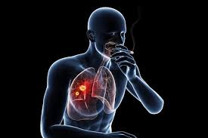
SMOKING AND CANCER
BY- MALIKA MUDIT
1/5

Slide 2
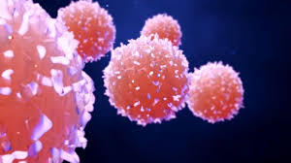
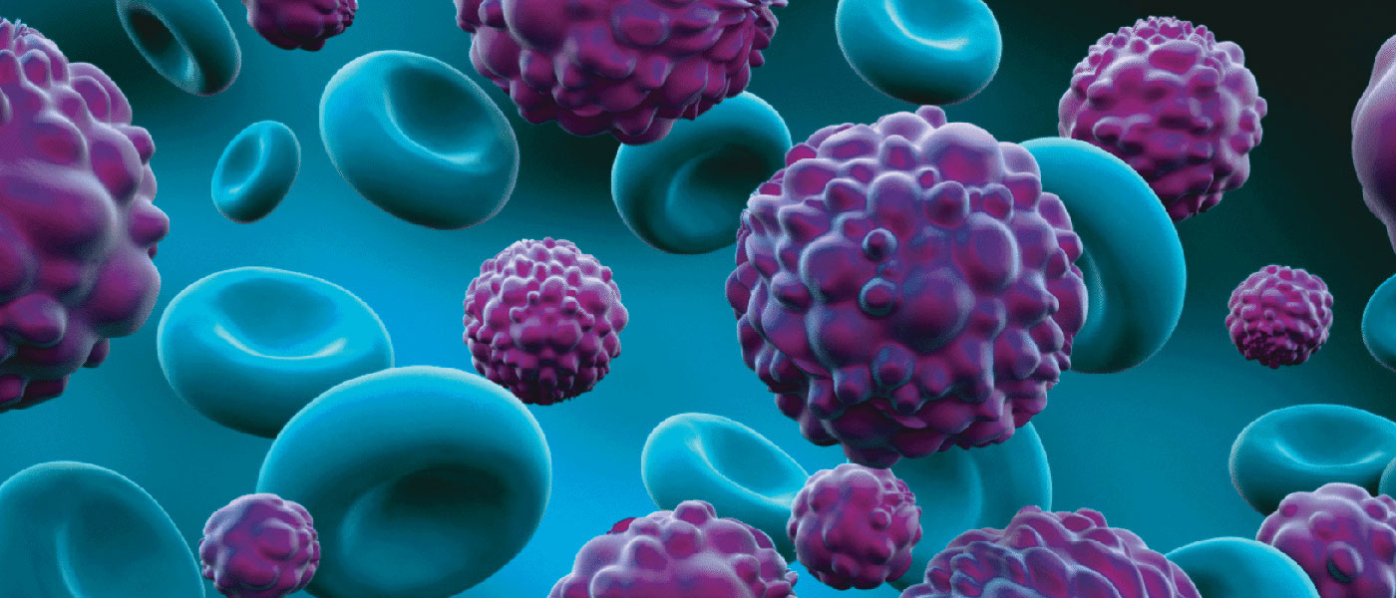
WHAT IS CANCER?
Cancer are the diseases in which abnormal cells divide uncontrollably and are able to invade other tissues.
The cancer causing cells can spread to other parts of the body through the blood and lymph systems.
There are more than 100 types which include the common ones like skin cancer, lung cancer, breast cancer etc.
2/5

Slide 3
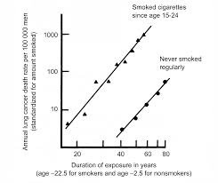
CORRELATION BETWEEN SMOKING AND CANCER
There is a strong positive correlation between the risk of getting cancer and the frequency of smoking.
A positive correlation indicates that when frequency of smoking increases, the risk of getting cancer increases too.
A correlation between the two doesn’t show causation but there are increased cases of lung cancer with the people who smoke.
3/5

Slide 4
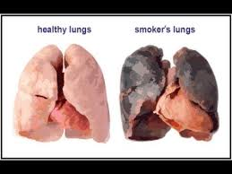
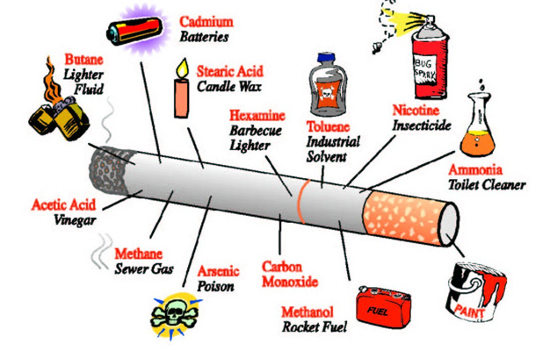
HOW DOES SMOKING EFFECT THE BODY?
The chemicals present inside a cigarette can weaken the immune system which makes it harder for it to get cured.
It can also cause damage to the DNA and the cells can divide continuously to form malignant tumours which are cancerous.
Therefore it has been said that smoking can cause cancer and it prevents the body to fight against it.
4/5

Slide 5
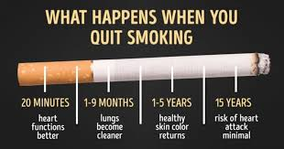
BENEFITS OF QUITTING SMOKING
The heart rate and the blood pressure come back to normal and the carbon monoxide levels in the blood reduce.
This helps in in better circulation of the blood as decrease of carbon monoxide increases the blood’s ability to carry oxygen.
After months of quitting, there is an improvement in the lung function and it lowers the chances of cancer and other chronic diseases.
5/5

