Slide 1
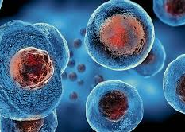
STEM CELLS
By Malika Mudit
1/8

Slide 2
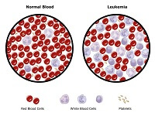
LEUKEMIA
Leukemia is a cancer of the blood. It generally affects the production of blood cells, mainly white blood cells which protect the body against infectious diseases.
There is rapid production of abnormal white blood cells in the body.
Some of the symptoms are fatigue, weight loss, frequent infections and easy bleeding or bruising.
2/8

Slide 3
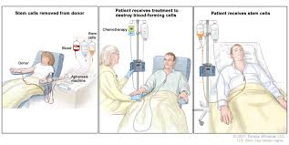
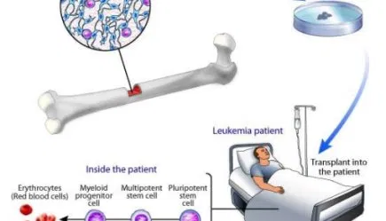
USE OF STEM CELLS TO CURE LEUKEMIA
Stem cells can replace the leukemia cells by producing new ones that can actually produce blood.
Before using the stem cells, the patient has to undergo chemotherapy to destroy the existing cancer cells in the blood or bone marrow.
After doing so, these cells can be replaced by the new stem cells which can either be donated or can be collected from the patient’s body itself.
3/8

Slide 4
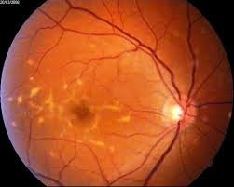
STARGARDT’S DISEASE
It is a genetic disease that develops in children from ages 6 to 12.
The disease causes progressive damage of the macula, which is a small area in the center of the retina which is responsible for our straight vision.
It causes a membrane protein used for active transport in the retina cells to not function properly.
Symptoms of Stargardt’s disease can include blurry or distorted vision, inability to see in low lighting and difficulty recognizing familiar faces. In late stages of Stargardt's, color vision also may be lost.
4/8

Slide 5
USE OF STEM CELLS TO CURE STARGARDT’S DISEASE
This disease can be cured by using stem cells to regenerate the dead cells in the retina.
The stem cells get attached to the retina and remain there.
Before performing this procedure on humans it was tested on mice where the results were actually successful and the vision of the mouse improved.
5/8

Slide 6
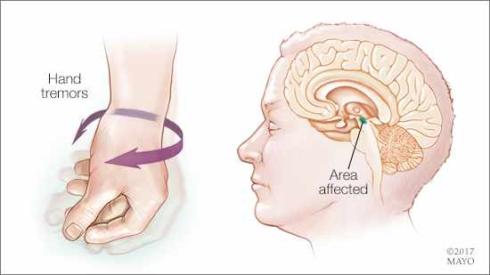
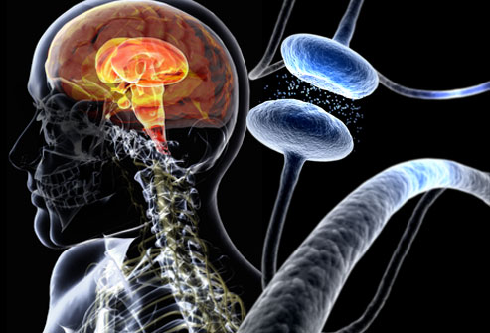
PARKINSON’S DISEASE
Parkinson's disease is a progressive disorder that is caused by degeneration of nerve cells in the part of the brain called the substantia nigra, which controls movement.
These nerve cells die or become impaired, losing the ability to produce an important chemical called dopamine.
Some of the symptoms are- tremors, slowed movement, rigid muscles, impaired posture and balance, change in speech and change in writing.
6/8

Slide 7
USE OF STEM CELLS TO CURE PARKINSON’S DISEASE
In Parkinson’s disease, cells that make the chemical messenger dopamine degenerate and die.
Introducing new dopamine cells into the brain may help replace what is lost in the disease and reduce its symptoms.
Such a treatment could also help reduce medication side effects.
7/8

Slide 8
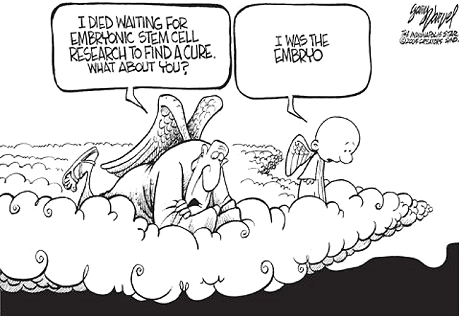
ETHICS OF USING THE STEM CELLS
Although stem cells have become an important part of medical research, there are some ethical issues that have come up.
Using the embryonic stem cells has a lot of benefits but while obtaining the stem cells, the embryo dies which is considered to be unethical.
But there are arguments about this issue as everyone questions the fact that when does human life begin?
Some say that it begins when the zygote is formed and killing it can be considered as murder. Whereas others contradict this by saying that the embryos were donated by the people who knew that these embryos wouldn’t have come to term.
8/8

